Slide 1

Welcome To My Presentation
TOPIC NAME:COMPUTER SYSTEM REVIEW

Slide 2
Course code : cse-0310
(OPERATING SYSTEM)
Submitted To
Khan Md. Hasib
M.Sc. in CSE (Ongoing), Brac University, B.Sc. in CSE, Ahsanullah University of Science & Technology (AUST)
Lectur of
STATE UNIVERSITY OF BANGLADESH
Submitted By
Tasnova Tasnim
UG02-47-18-012

Slide 3
What is an Operating System?
An operating system is a program that manages the computer hardware.
It also provides a basis for application programs and acts as an intermediary between a user of a computer and the computer hardware.

Slide 4
Goals of an Operating System
ü The primary goal of an operating system is thus to make the computer system convenient to use.
ü The secondary goal is to use the computer hardware in an efficient manner

Slide 5
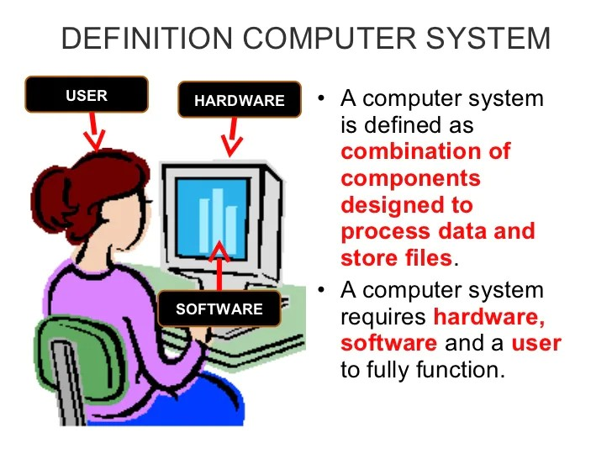

Slide 6
BASIC ELEMENTS OF A COMPUTER SYSTEM
ü An operating system is an important part of almost every computer system.
A computer system can be divided roughly into four components.
v Hardware
v Operating system
v The application programs
v Users

Slide 7
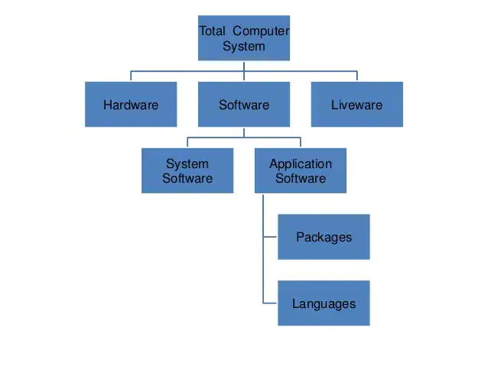

Slide 8
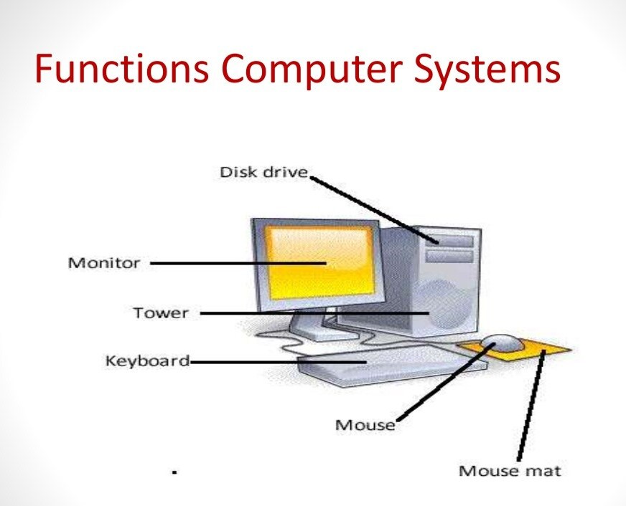

Slide 9
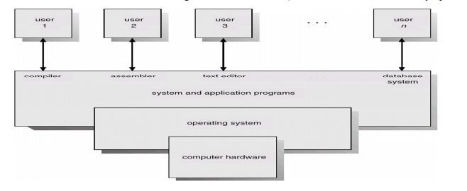
Abstract view of the components of a computer system

Slide 10
Mainframe Systems
ü The operating system in these early computers was fairly simple.
ü Its major task was to transfer control automatically from one job to the next.
ü The operating system was always resident in memory

Slide 11
Computer-System Architecture
Computer-system operationOne or more CPUs, device controllers connect through common bus providing access to shared memory.Concurrent execution of CPUs and devices competing for memory cycles.Operating System Concepts

Slide 12
Operating System Services
Program execution – system capability to load a program into memory and to run it.
I/O operations – since user programs cannot execute I/O operations directly, the operating system must provide some means to perform I/O.
File-system manipulation – program capability to read, write, create, and delete files.
Communications – exchange of information between processes executing either on the same computer or on different systems tied together by a network. Implemented via shared memory or message passing.
Error detection – ensure correct computing by detecting errors in the CPU and memory hardware, in I/O devices, or in user programs.
Operating System Concepts

Slide 13
Thank you

